Slide 1
DCGAN (for inpaintig)

Slide 2

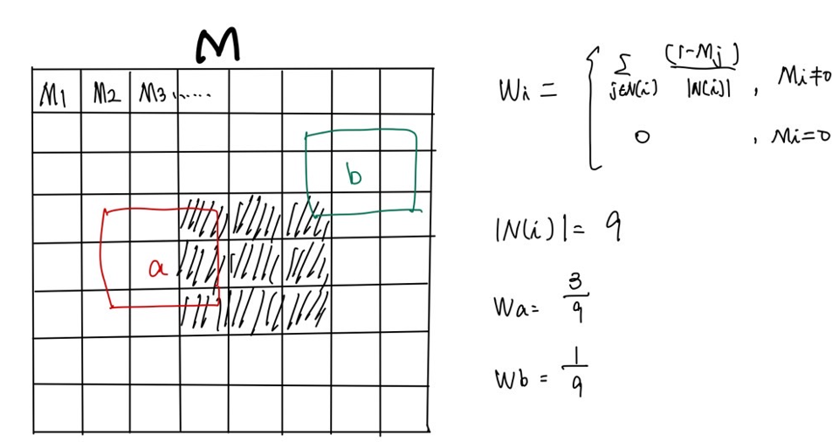


Train_stage:
Algorithm(train)
1.Choose code randomly
2.Compute the gradient Loss_total
3.Optimal the code
code = code + lr *
4.Input code to generator for inpainting
5.Repeat 2.~5. until context_loss < 1
and prior_loss < 2
or epoch >= max_times
Pre_train:
iid
code
U(-1,1)
BP
Loss_total
Real
fake
code
G
Gen_img
D
code
BP
Train:
E
BP
E
code
G
Real
fake
Gen_img
D
How to make the mask:
BP
Context_loss
Back propagation
Code = code + lr *
Where Loss_total = Loss_c + Loss_p
Prior_loss
Loss_total
code

Slide 3
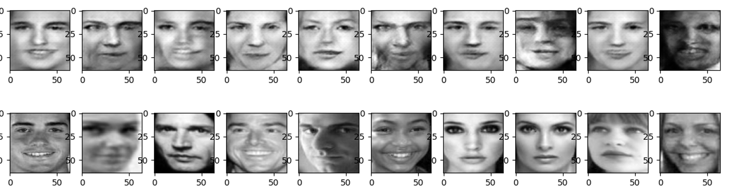
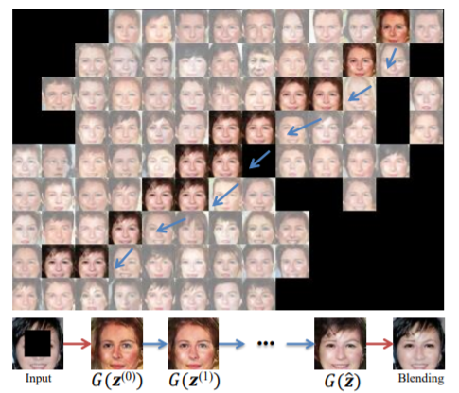
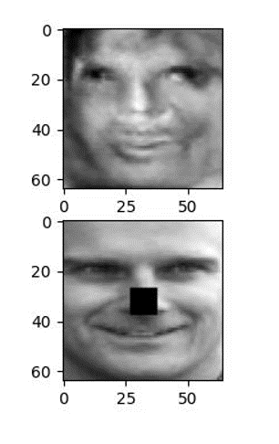
Result :
Given noise to produce the image
Update the noise for the inpainting
(choice the noise randomly)

Slide 4
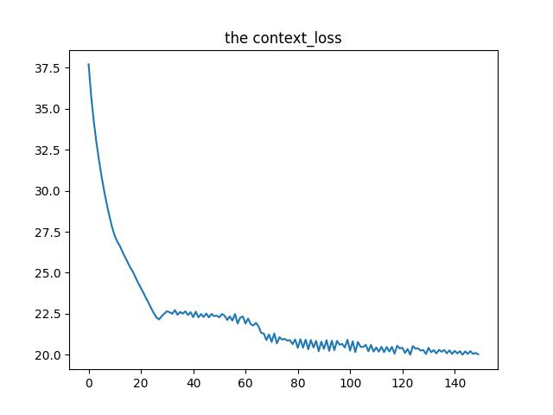
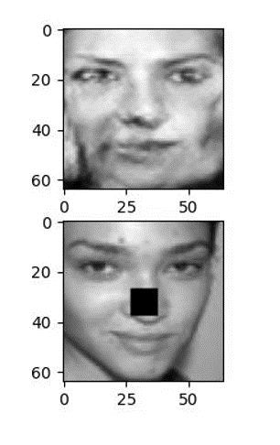
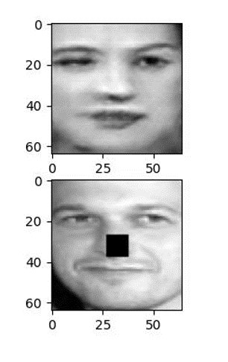
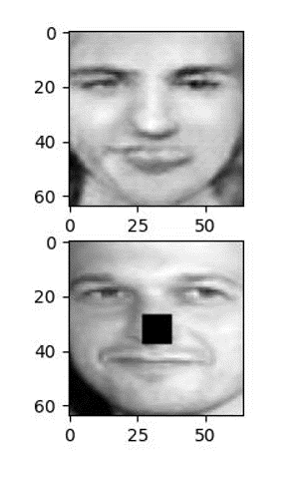
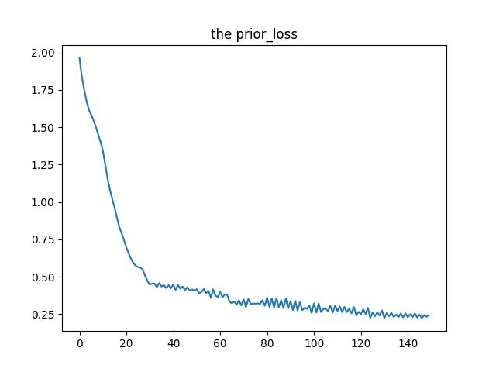
Result:
Mask 的不合理性:
在多處需要inpainting 或背景太過複雜時，mask 是必須的，
但當只有一處需要inpainting時用本篇方法mask 是不適用的。
實驗組
對照組
No mask
No mask
Use mask

